Slide 1

Bundesliga-betting-predictor
Which soccer team will lose, win or play a draw in the upcoming game(s)?
Simon

Slide 2
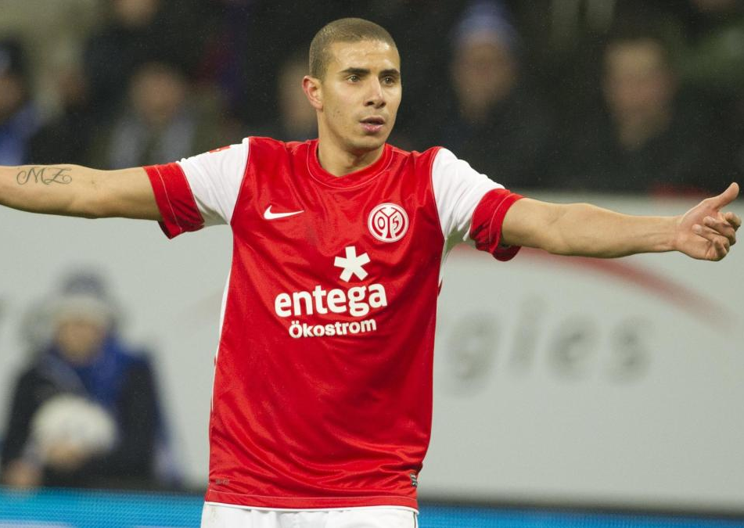
1st Bundesliga?
Germany's primary football competition
top 18 teams
306 matches (153 + 153) in 34 (17 + 17) games per season
Points:
win = 3
draw = 1
lose = 0

Slide 3
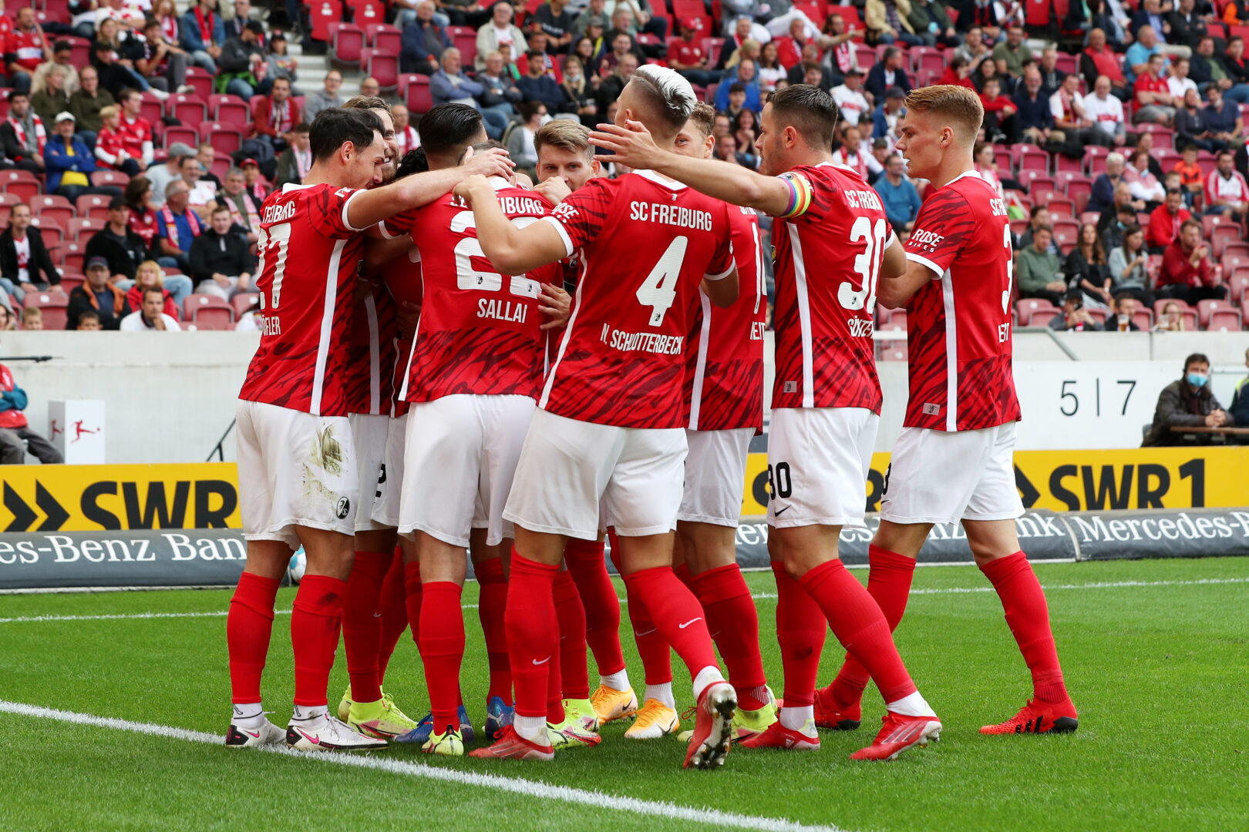
Components
API:
https://www.openligadb.de/
tables with total scores of all teams
tables with all games and results
Machine Learning Models:
Logistic Regression
Support Vector Classification
Random Forest Classifier
XGBoost
Notes:
XGBoost:
# produces a prediction model in the form of an ensemble of weak prediction models, typically decision tree
# the outcome (dependent variable) has only a limited number of possible values.

Slide 4
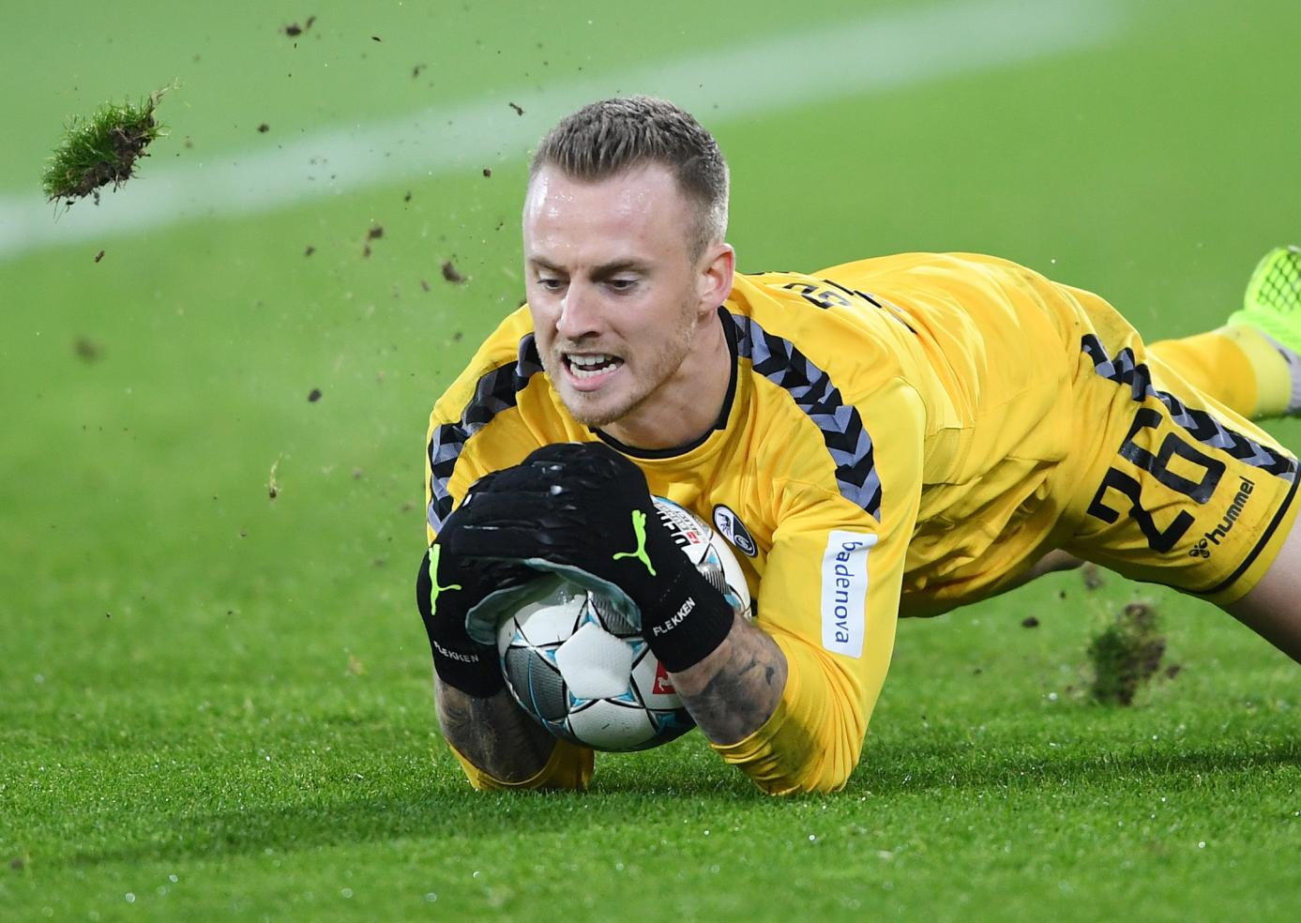
Goal
Predict result with 3 possibilities:
H = Home team wins
A = Away team wins
D = Draw
Probabilities so far:
H = 33,33 %
A = 33,33 %
D = 33,33 %
→ a model that predicts more than 33.33% of the results correctly is already better than just guessing

Slide 5
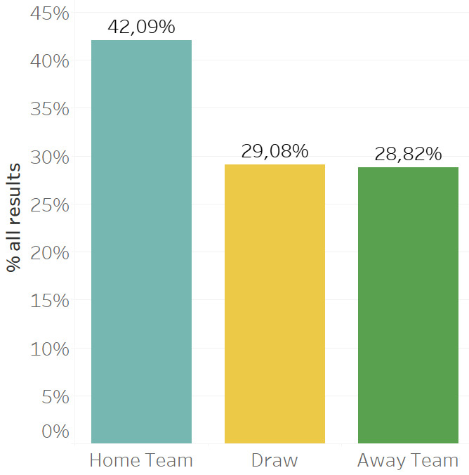
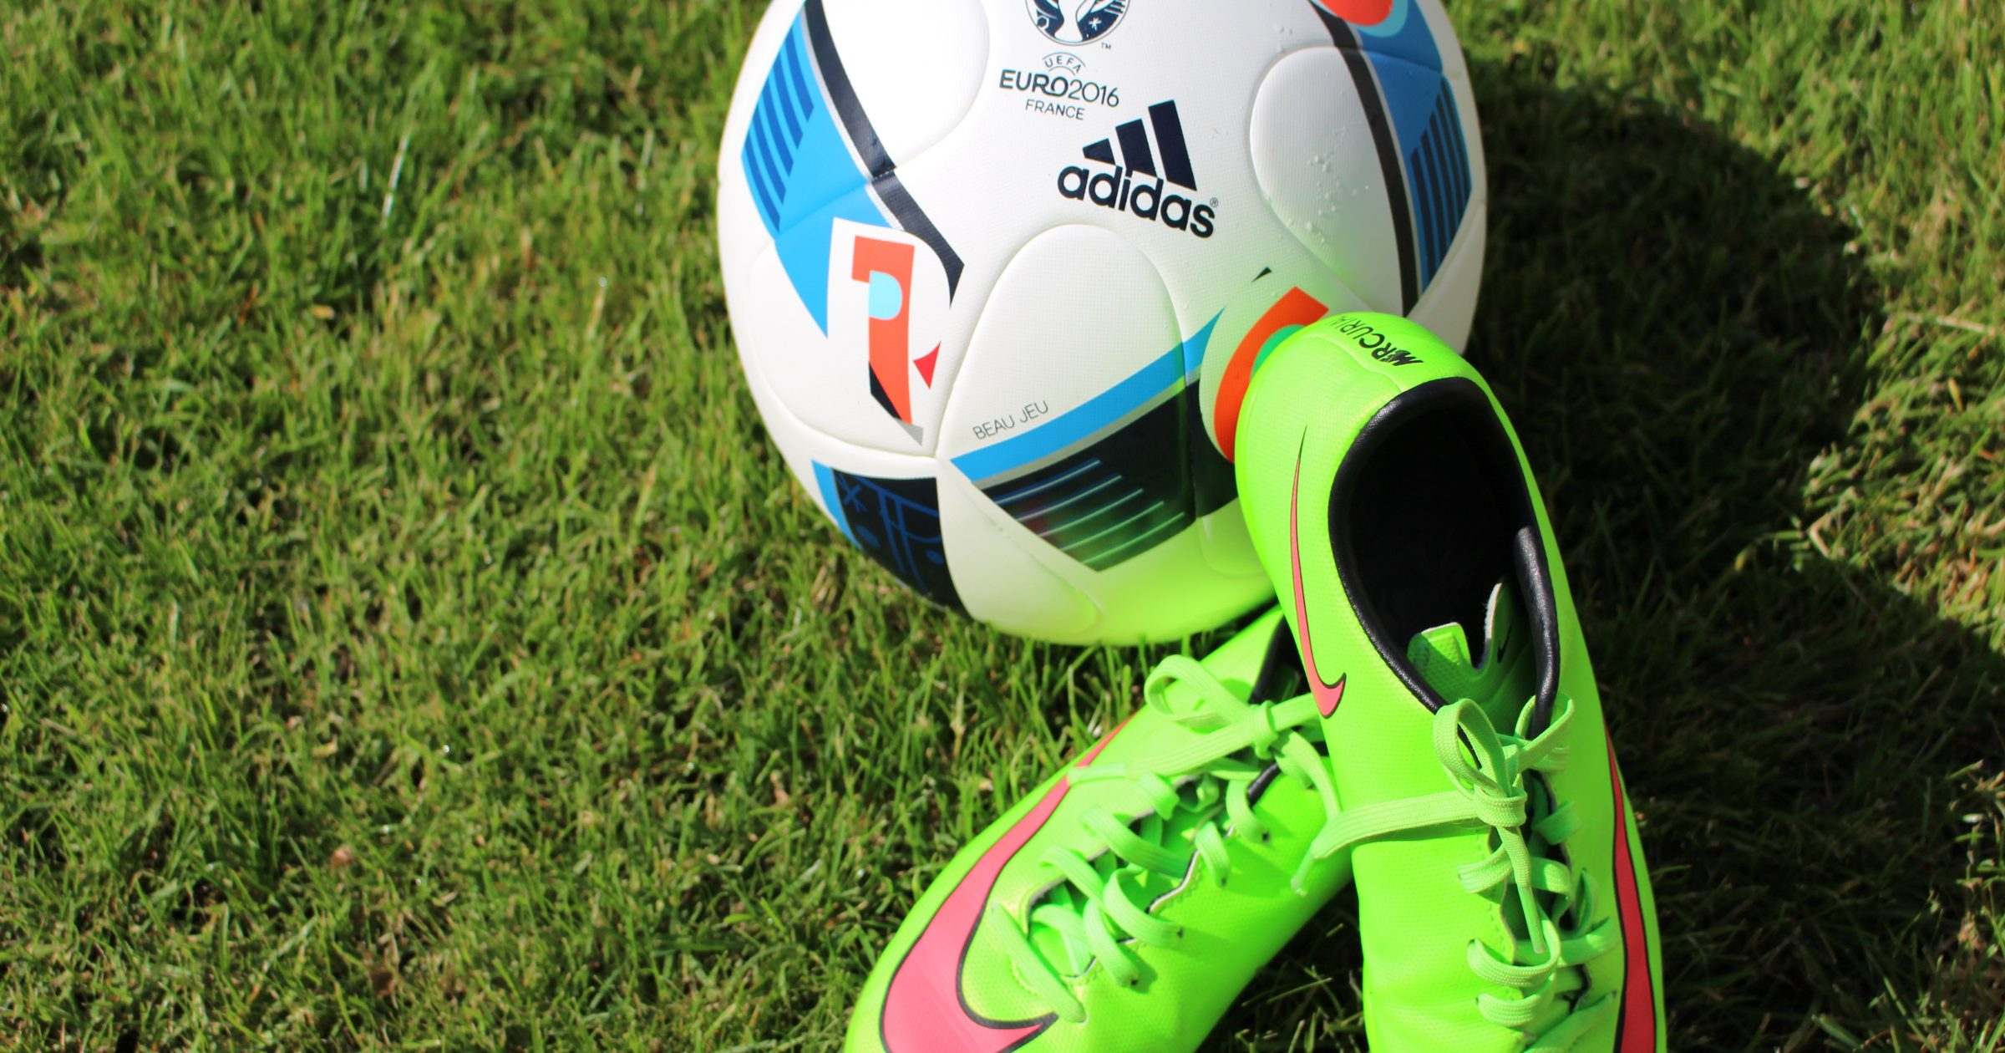
1st Analysis
Total number of matches: 3060
Number of matches won by home team: 1288
Win rate of home team: 42.09%

Slide 6
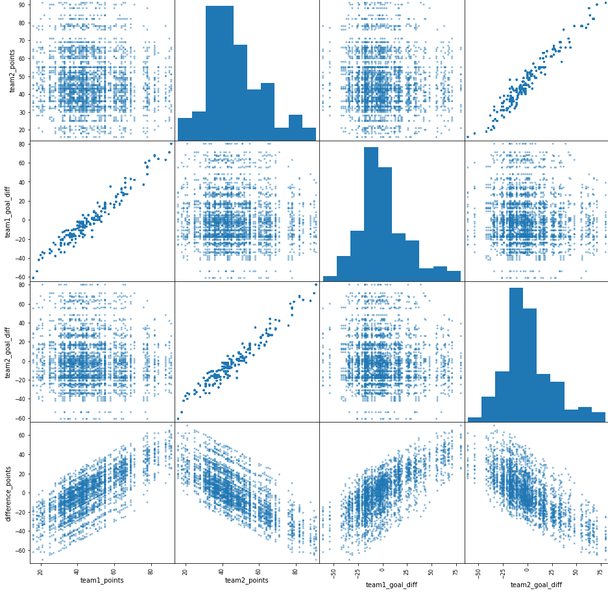

Slide 7
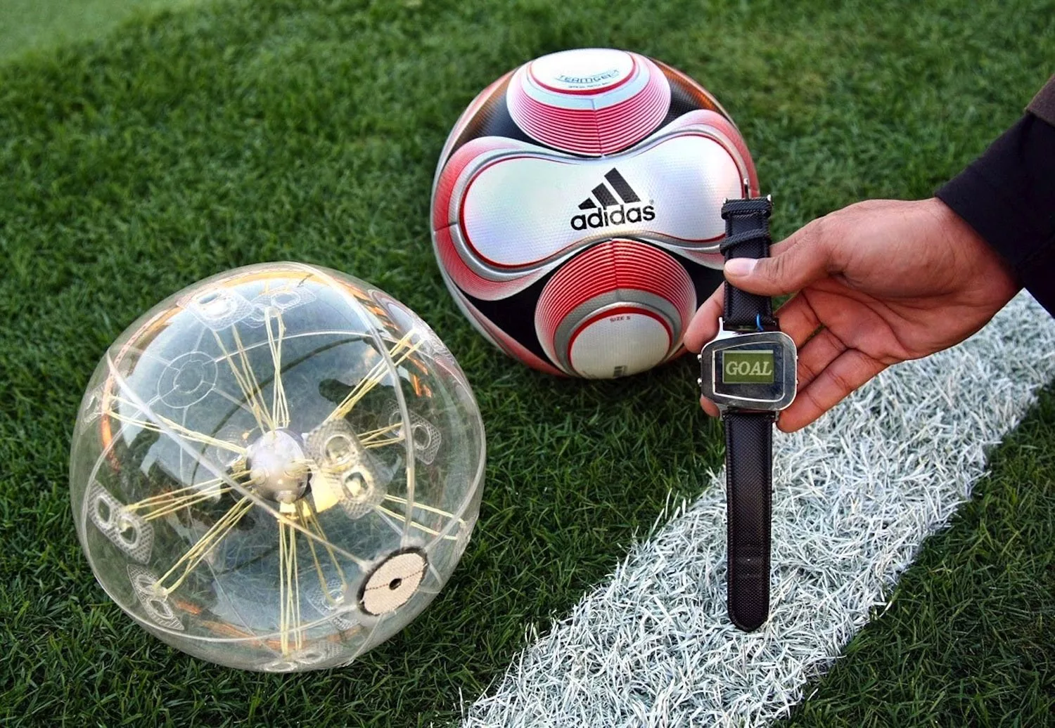
Machine Learning
Used features for Home & Away Team per season:
sum of points
sum of goals
sum of opponent goals
sum of won games
sum of lost games
sum of draws
target:
H = Home team wins
A = Away team wins
D = Draw

Slide 8
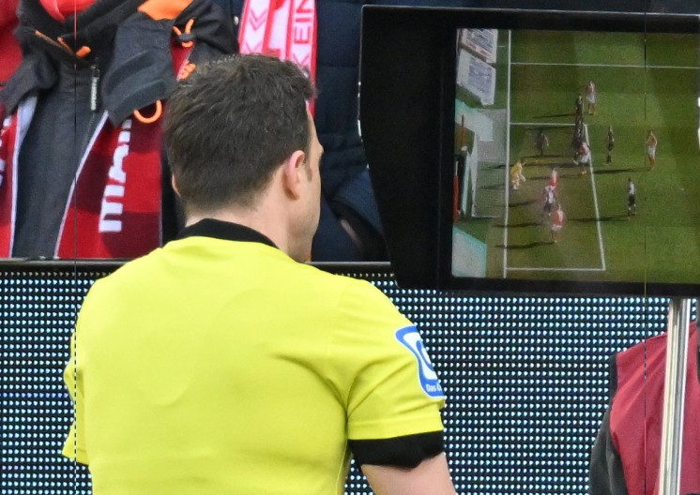
Machine Learning
Models:
Logistic Regression
Support Vector Classification
Random Forest Classifier
XGBoost
Data of seasons 2011 - 2020:
tables with total scores of all teams
tables with all games and results
→ Predict games for season 2021 and compare with real results

Slide 9
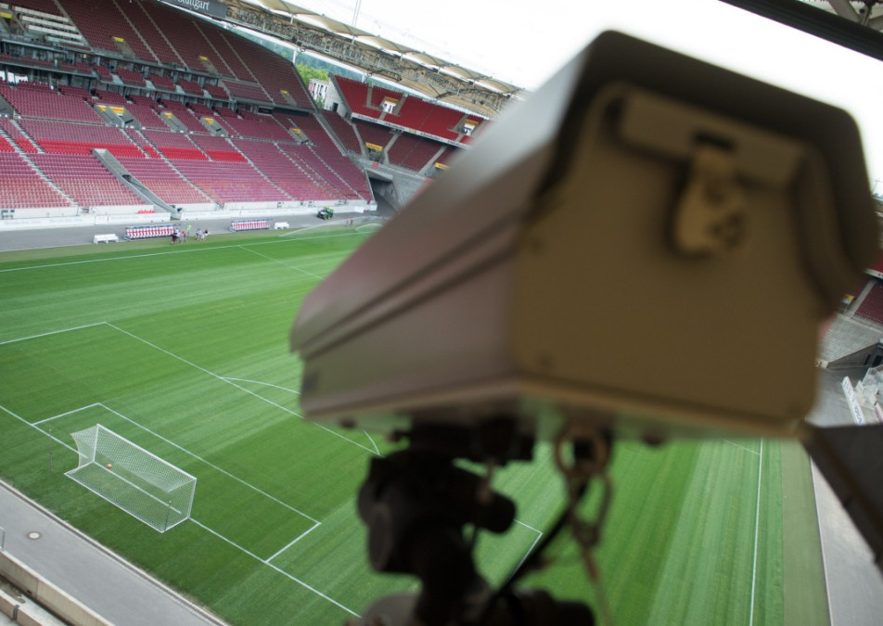
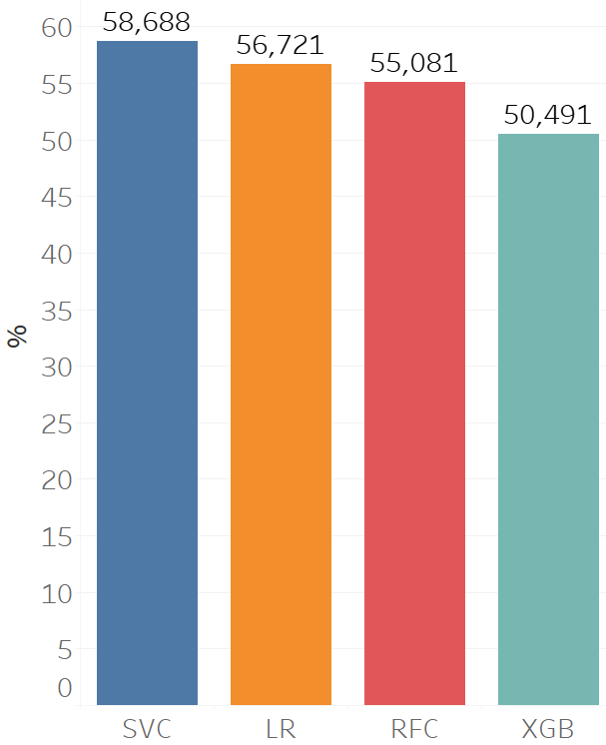
Machine Learning

Slide 10
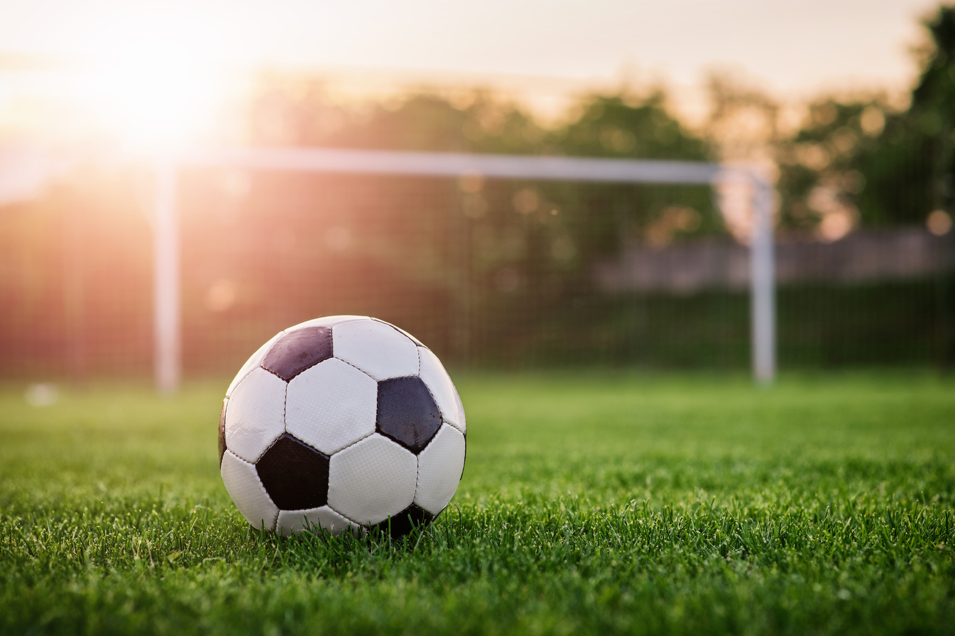
Predicting the upcoming season 2022
Now difficult for the whole season
results of future games must be included in the ML model

Slide 11
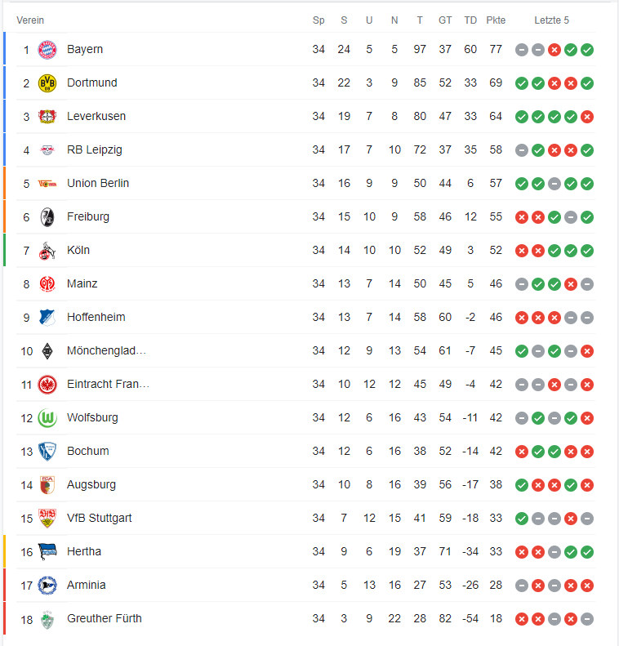
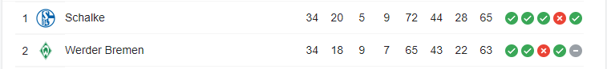
Predicting the upcoming season 2022
league climber

Slide 12
Predicting the upcoming season 2022
0 = Home team wins
1 = Away team wins
2 = Draw
Example | depending if this is the constellation of the 1st 2 game days like in season 2020

Slide 13
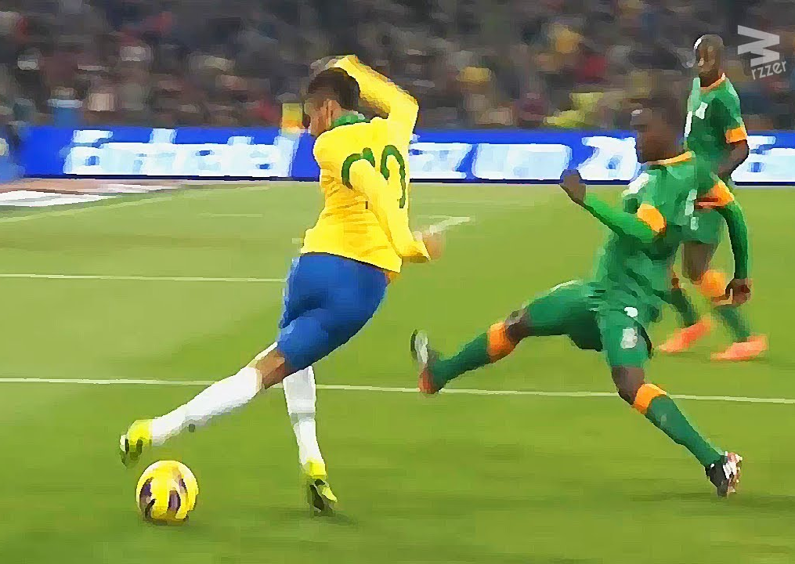
Next steps
Improvement of the chosen features regarding daily accuracy
maintenance of the ML models after each game day
re-checking the accuracy of all selected ML models

Slide 14
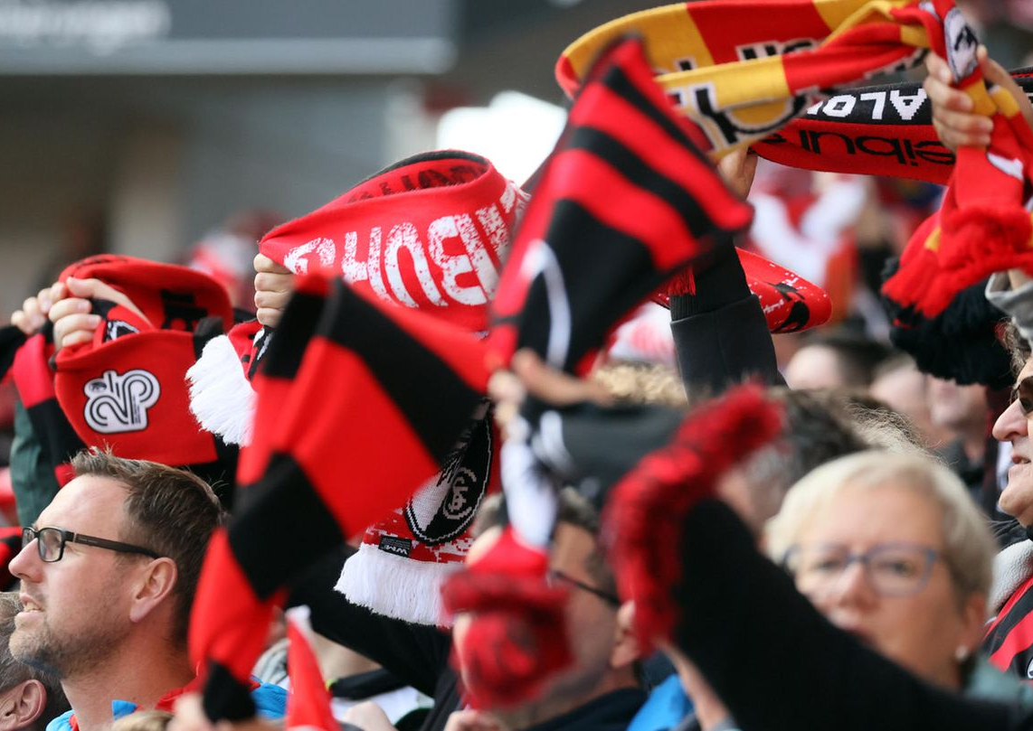
Thanks for your attention
Simon

